Slide 1










Chemnitz 2025
European Capital of Culture
- C THE UNSEEN -

Slide 2

European Capitals of Culture
The biggest cultural project of the EU
since 1985
more than 70 cities in total
2025
40th anniversary of the European Capitals of Culture

Slide 3
Germany
1988 Westberlin
1999 Weimar
2010 Essen and the Ruhr region
2025 Chemnitz and the Ore Mountains
(Title given on 28.10.2020)

Slide 4
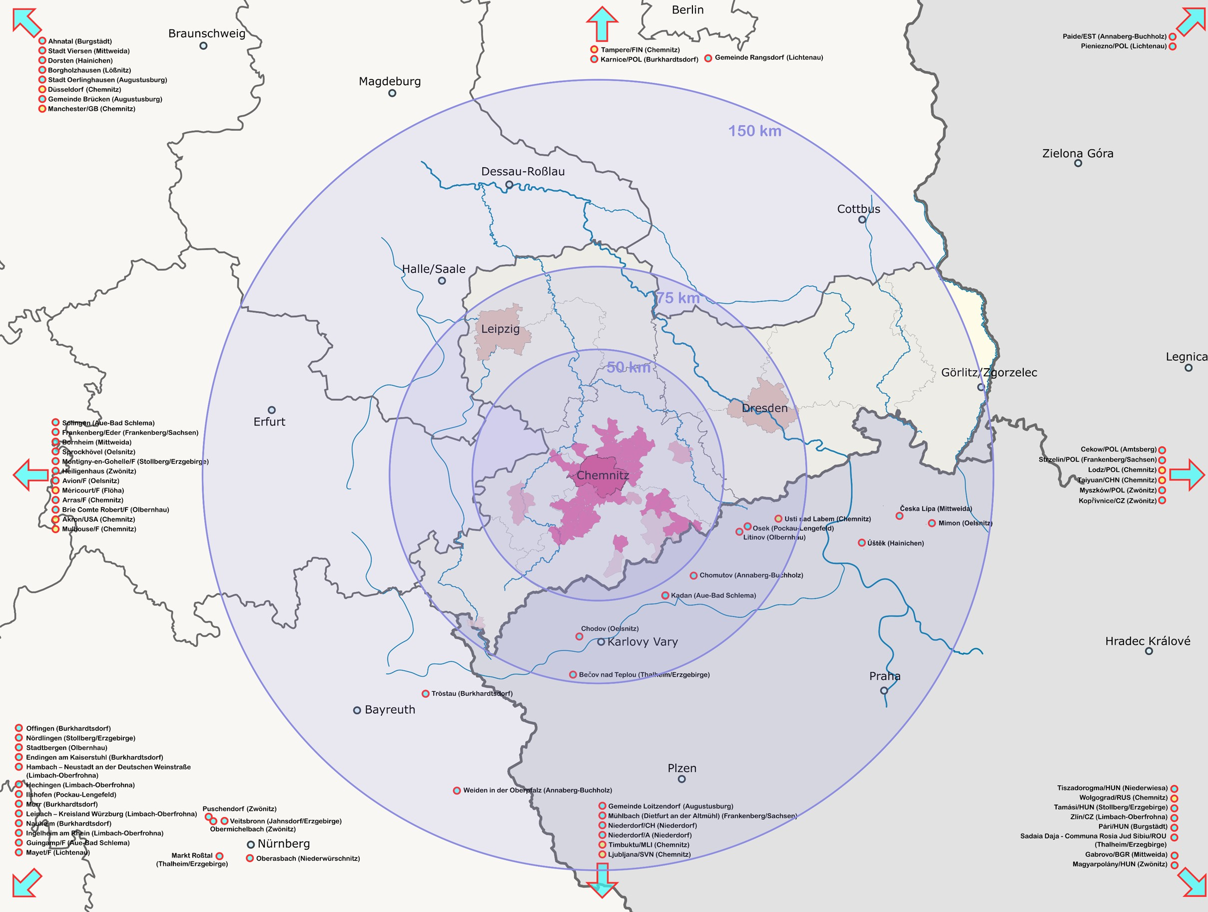
Characteristics
Chemnitz +
38 municipalities/region
Central Saxony
Zwickau and
Erzgebirge (Ore Mountains)

Slide 5

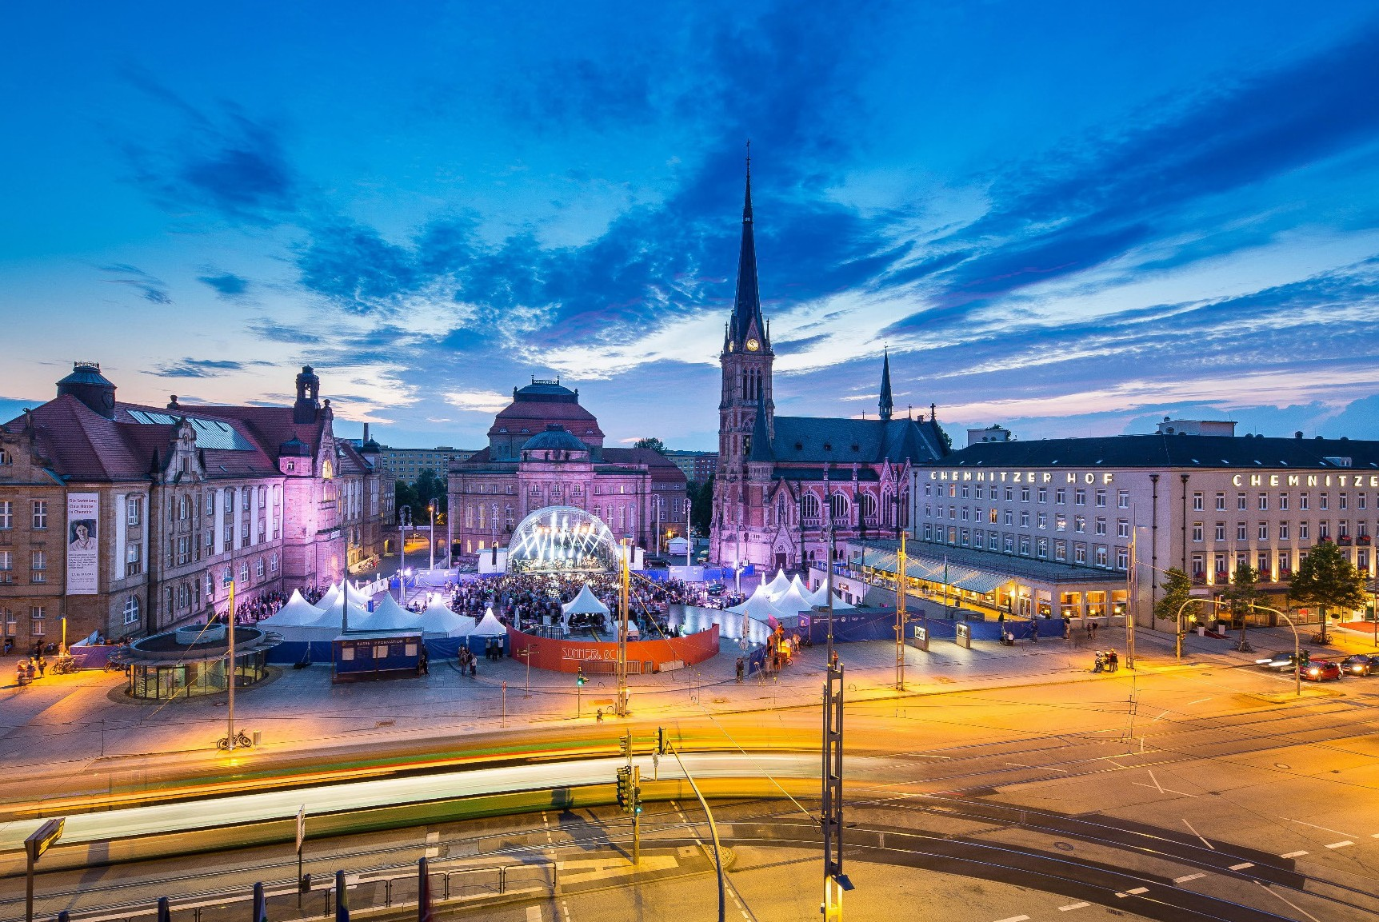
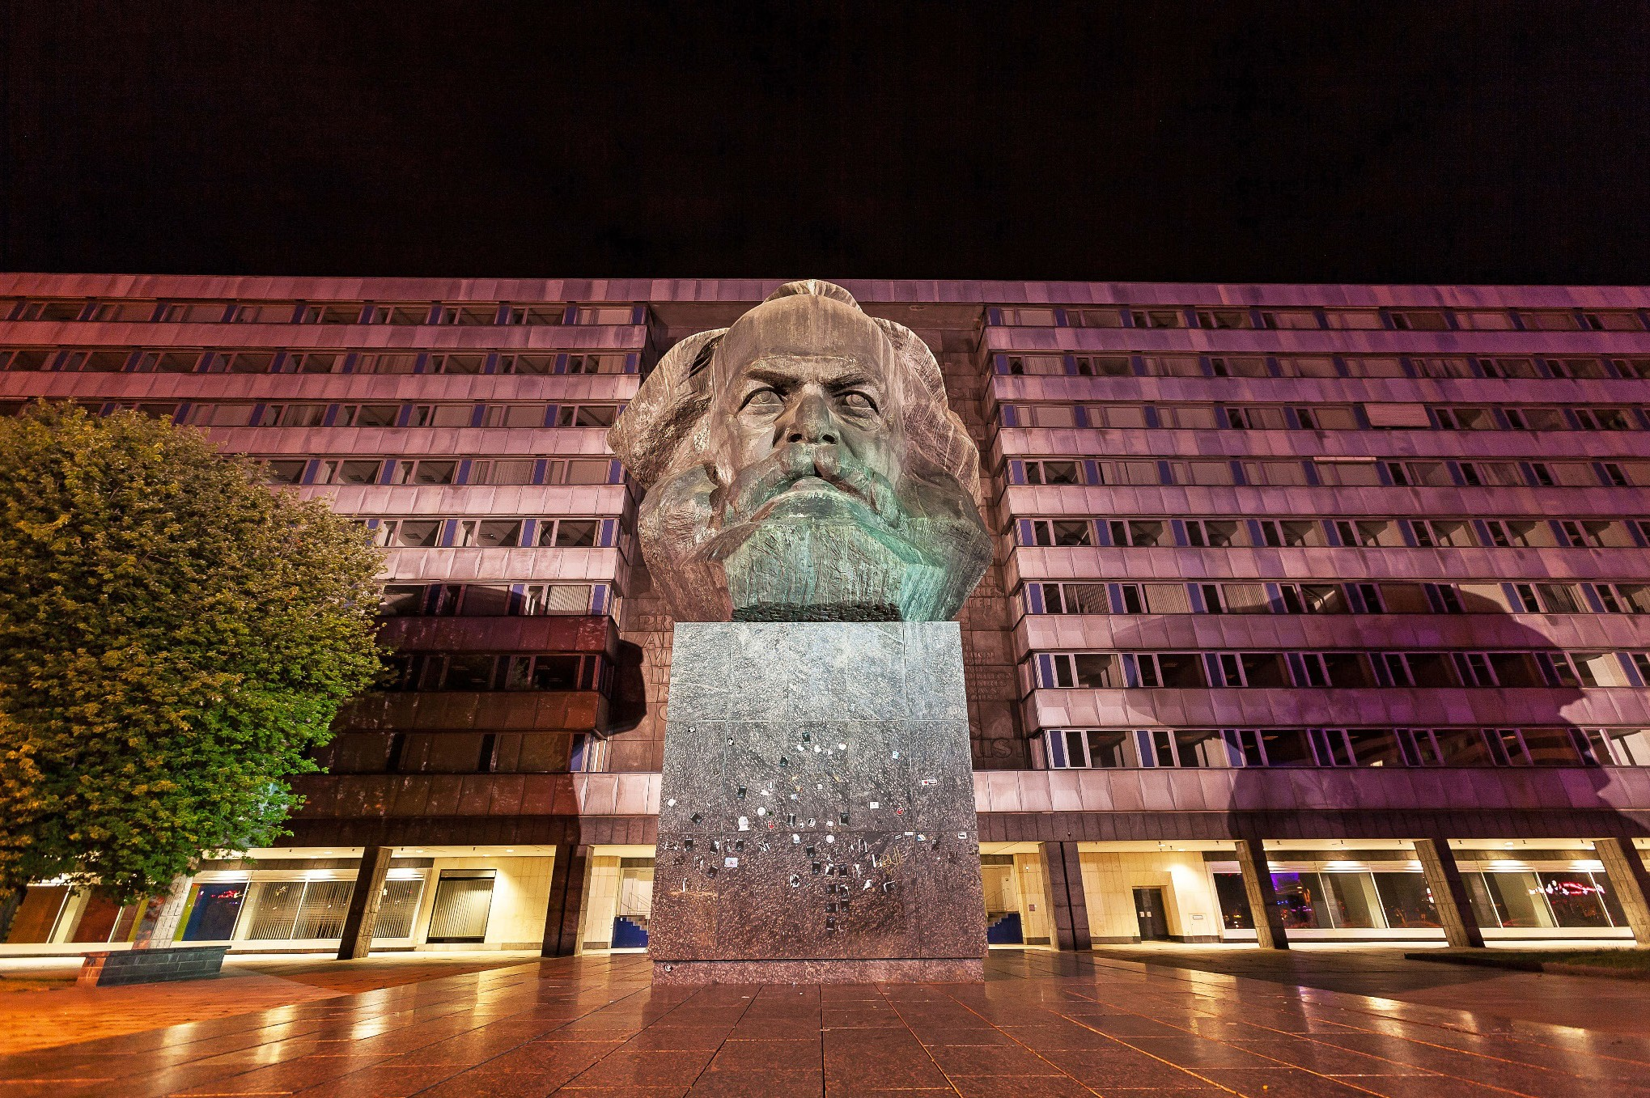
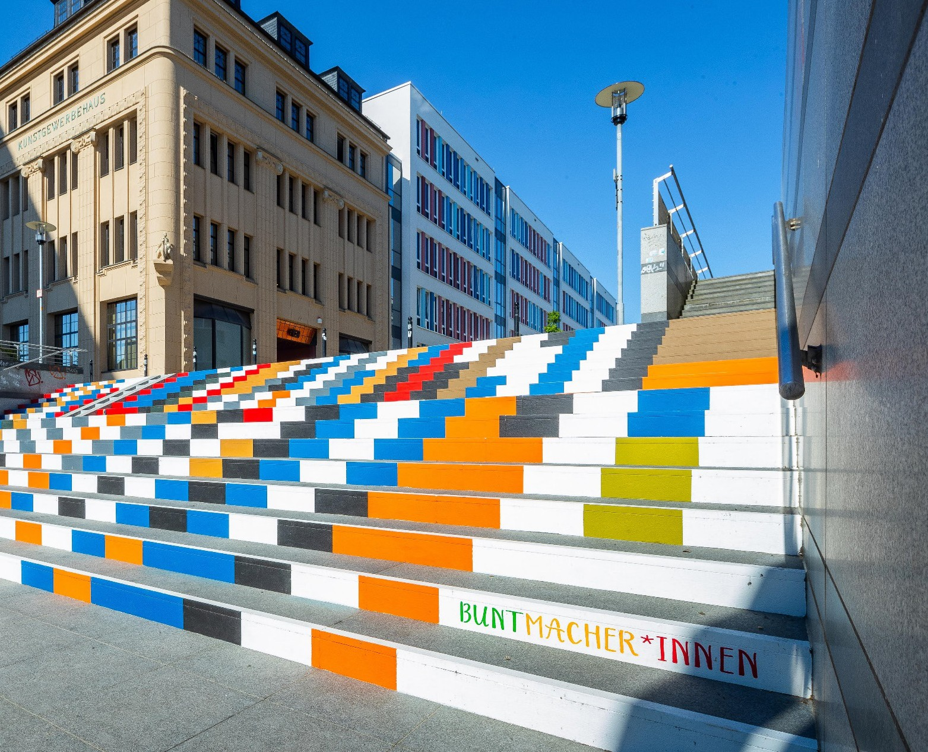
City of Chemnitz
250.000 inhabitants
+ region app. 1,5 mil
2025 tourists:
+/- 2 mil visitors extra

Slide 6
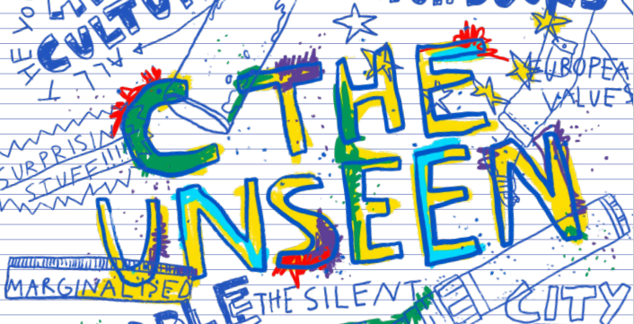
C THE UNSEEN
Motto of Chemnitz 2025 + region:

Slide 7
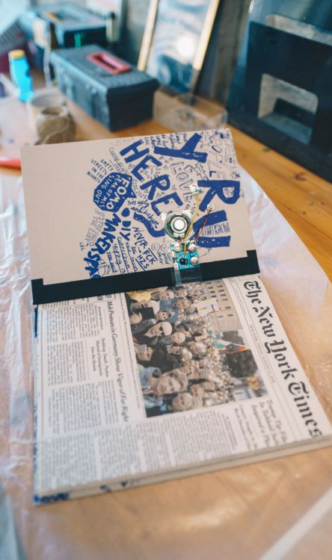
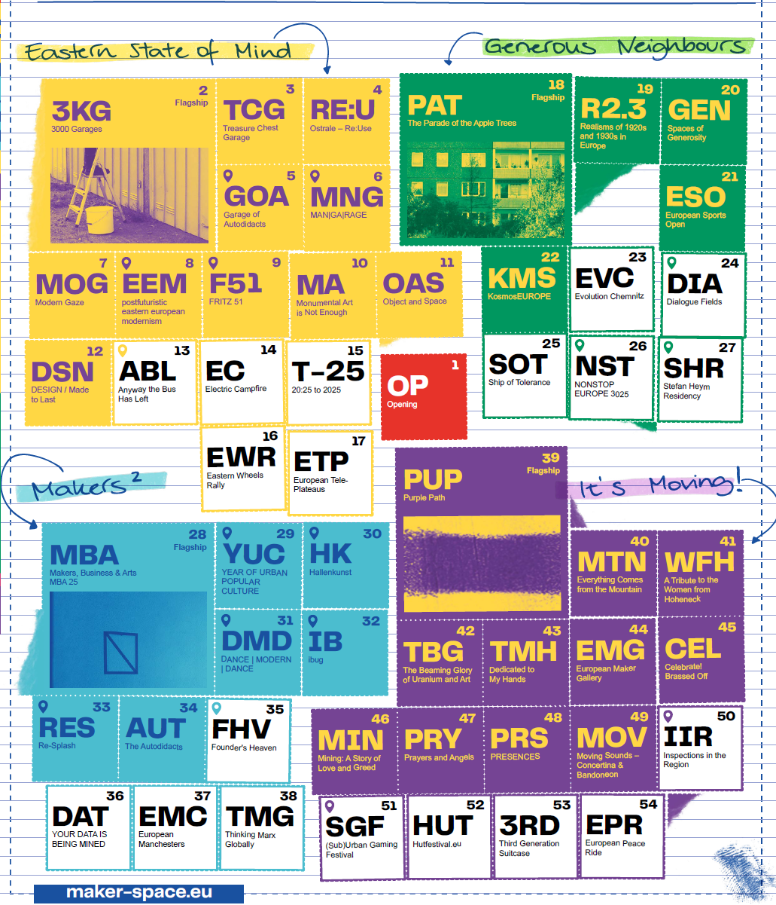
Programme fields
The bid book II
five programme fields
inhouse projects of Chemnitz2025 GmbH
+ projects with external partners

Slide 8
Programme fields + in-house projects
European Maker of Democracy
          European Workshop for Culture and Democracy
    Eastern State of Mind
    3000 Garages
    Generous Neighbours
    Generous Neighbours
    Makers2
    Makers, Business and Arts (MBA)
    It‘s Moving!
    Purple Path

Slide 9
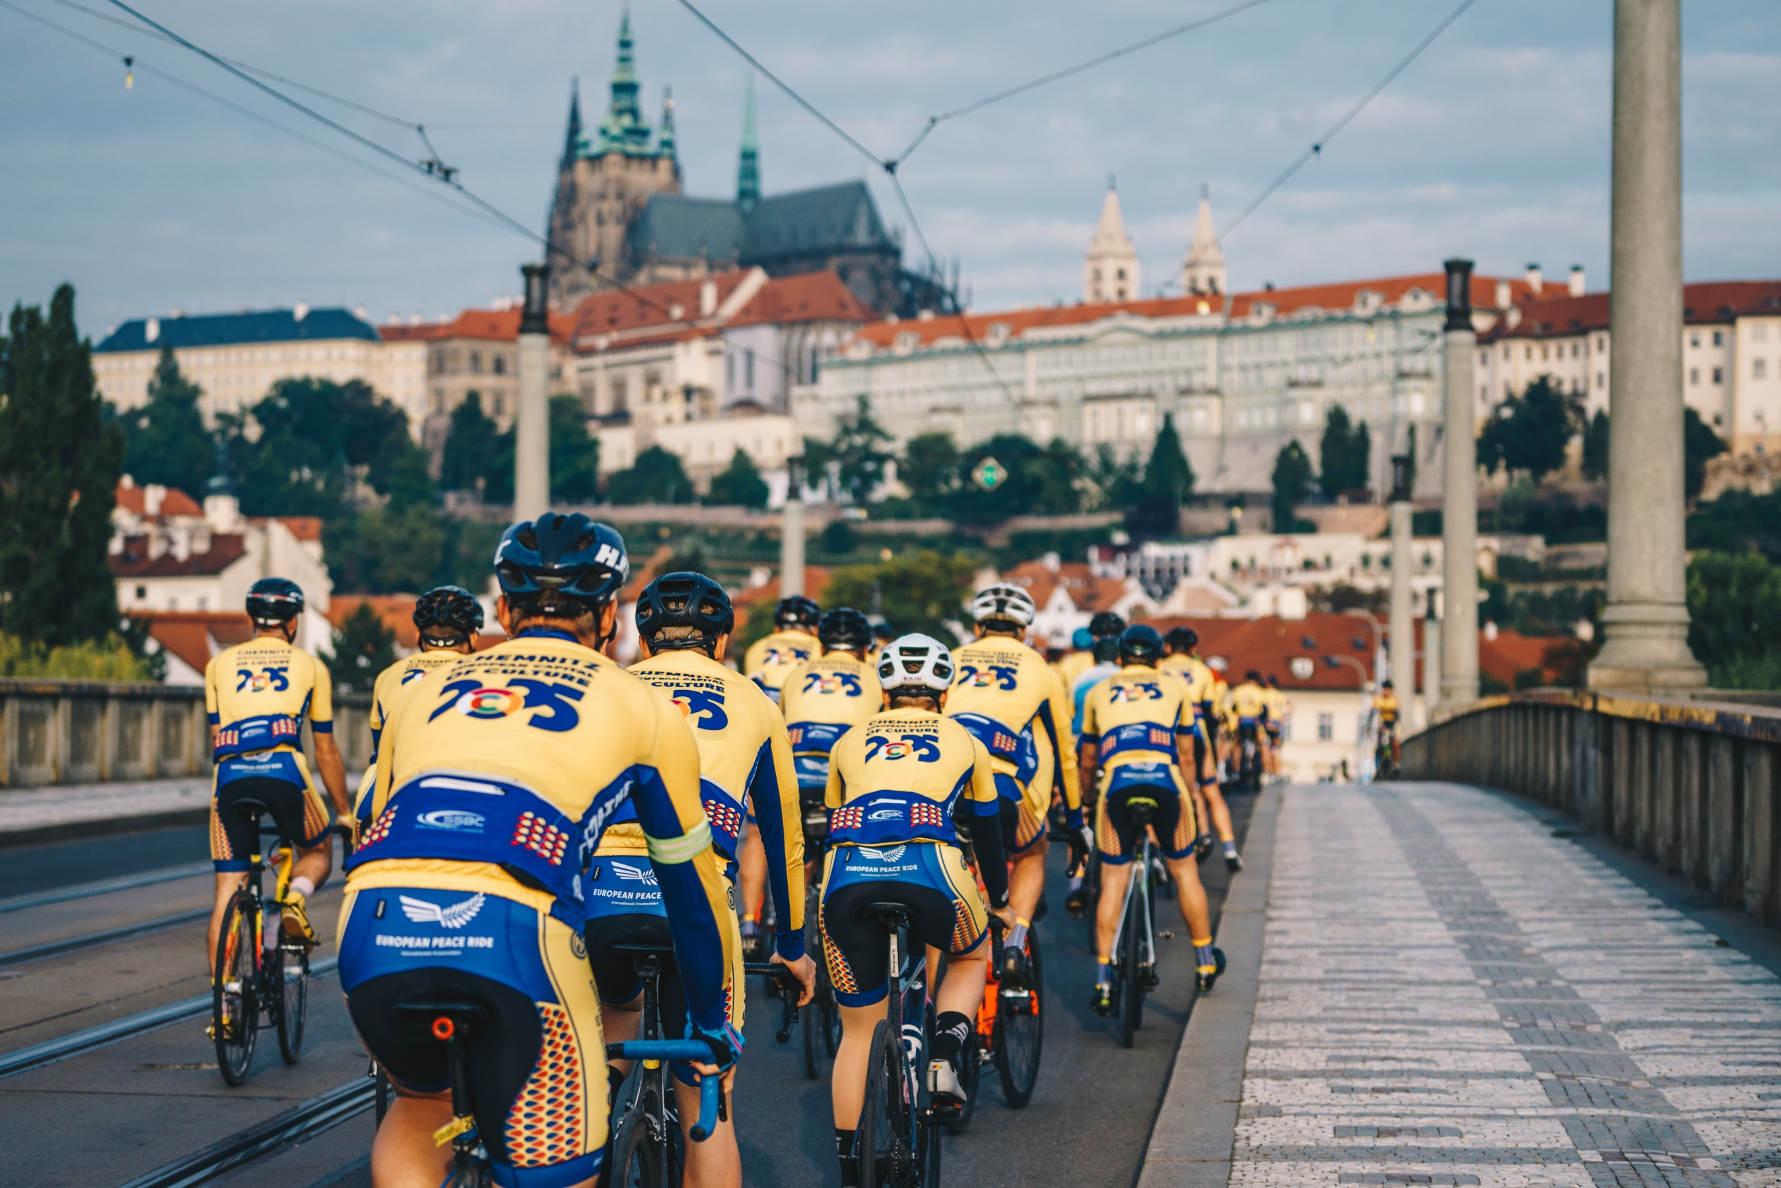
Collaborations with Prague and the CR
12.09.2021 European Peace Ride goes Chemnitz – Prag - Chemnitz
Meeting of Lord Mayor Sven Schulze with Mr. Lord Mayor Hřib and Mrs. Třeštíková on this occassion
2022-23 meetings with partnering institutions to foster cooperation:
Key partners:
Saxon Liaison Office
German Embassy
City of Prague/Prague Municipal Culture Office
Ministry for Culture of the Czech Republic
Czech German Future Fund
Goethe Insitut Prague
IDU
Kreativni Praha
Czech Tourism
Prague Tourism
and others…
Public presentations in Prague in the Saxon Liaison Office (2022) and the German Embassy (2023)
Strengthening also the relations with fellow ECoCs such as Plzen, Budweis and our twin town Usti nad Labem
© Ernesto Uhlmann

Slide 10
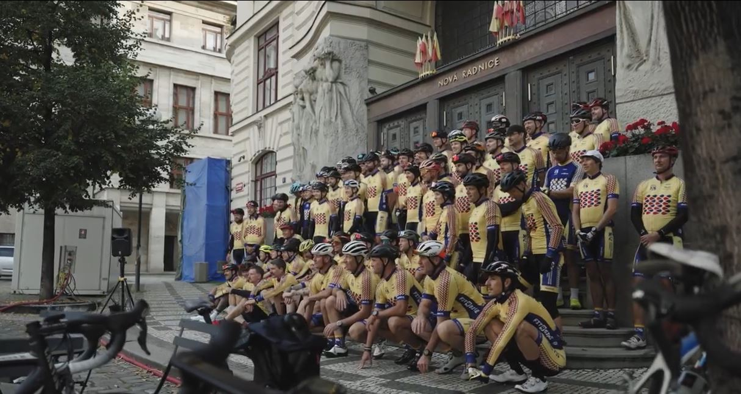
Collaboration with Prague and the CR
CULTURAL AIMS
strengthening practical cooperation a year before the ECOC
aim for a sustainable long term impact on cross-border cooperation in culture
Agencies and Stakeholder from both Chemnitz and Prague are starting to cooperate, we aim to foster those relations
Chemnitz has already had one open call for projects with Czech Republic, Poland and the Chemnitz regions, results will be known in spring 2024
Another call with the Czech-German Future Fund is planned for 2024
© Ernesto Uhlmann

Slide 11
Collaborations with Prague and the CR
TOURISM/CULTURAL AND CREATIVE TOURISM AIMS
interest in strengthening practical cooperation in cultural tourism a year before the ECOC between Chemnitz and Prague
Chemnitz is executing the German Travel Mart, April 21st to 23rd 2024 in Chemnitz,
Chemnitz is planning a strategic visit visit to meet touristic stakeholders in Prague after the GTM,
Strategical interest in connecting Chemnitz to Prague Airport
we aim for long term impact on cooperation in cultural tourism.
© Ernesto Uhlmann

Slide 12
We are looking forward to a fruitful exchange with you!
Kulturhauptstadt Europas Chemnitz 2025 GmbH

